Slide 1
EGB1201 – JAVA PROGRAMMING
END SEM PROJECT REVIEW
Department of Electronics and Communication Engineering
Academic Year: 2025 – 2026 (Odd Semester)
Register Number : 927624BEC035
Name : DHANUS VARMA R C
Year : II
Semester : III
Section : A
Date : 16-12-2025

Slide 2
Title of the Project
ONLINE AUCTION SYSTEM

Slide 3
Abstract
The Online Auction System is a Java-based console application that allows sellers to add items with a starting price and buyers to place bids. It maintains the highest bid and bidder for each item, ensuring fair competition. The system demonstrates object-oriented programming concepts such as classes, objects, and dynamic storage using Array List. It provides a simple model of real-world online auctions and can be extended with GUI, database, and authentication features.

Slide 4
Abstract with CO/PO Mapping
Abstract | CO | POs | PSO
The Online Auction System is a Java-based console application that allows sellers to add items with a starting price and buyers to place bids. It maintains the highest bid and bidder for each item, ensuring fair competition. The system demonstrates object-oriented programming concepts such as classes, objects, and dynamic storage using Array List. It provides a simple model of real-world online auctions and can be extended with GUI, database, and authentication features. | CO1,CO2 CO3 CO4 CO5 | PO1, PO2, PO3, PO4, PO5, PO6,PO7,PO8,PO9, PO10, PO11, PO12 | PS01 PS02

Slide 5
Introduction
The Online Auction System is a simple Java application that simulates the process of online bidding. In this system, sellers can list items with a starting price, and buyers can view available items and place bids. The program automatically tracks the highest bid and bidder, ensuring fair competition. This project demonstrates Java concepts like classes, objects, encapsulation, and Array List for dynamic storage. It provides a basic model of real-world e-auction platforms and serves as a foundation for future enhancements such as GUI, authentication, and database integration.

Slide 6
Literature Survey
SNO | PAPER TITLE | AUTHOR | YEAR | ADVANTAGES
1. | A Framework for Real time Online Auctions | Bernhard Rumpe | 2014 | Provides a Java-based real-time client–server architecture; ensures consistency in bid handling
2. | Verification of Combinatorial Vickrey Auctions | M. Caminati, J. Martin, C. Prehofer | 2013 | Ensures correctness and fairness of auction outcomes .
3. | Secure Electronic Auction Protocols: A Survey | Various Authors | 2022 | Highlights cryptographic techniques to enhance security and trust in online auctions

Slide 7
Java Programming - Concepts Used
Object-Oriented Programming Concepts
Classes and Objects – Used to structure main components like Users, Items, and Bids.
Methods – Used to perform actions such as placing bids and managing items.
Dynamic Data Handling
Array List / Collections Concept – Used to store and manage multiple records dynamically.
Control Statements
If–Else – Used for comparing bids and selecting the highest bidder.
Loops (for / while) – Used to repeat operations like checking available items.
Input Handling
Scanner Concept – Used for receiving user input in console-based design.
toString() Concept
Used for displaying object details clearly.

Slide 8
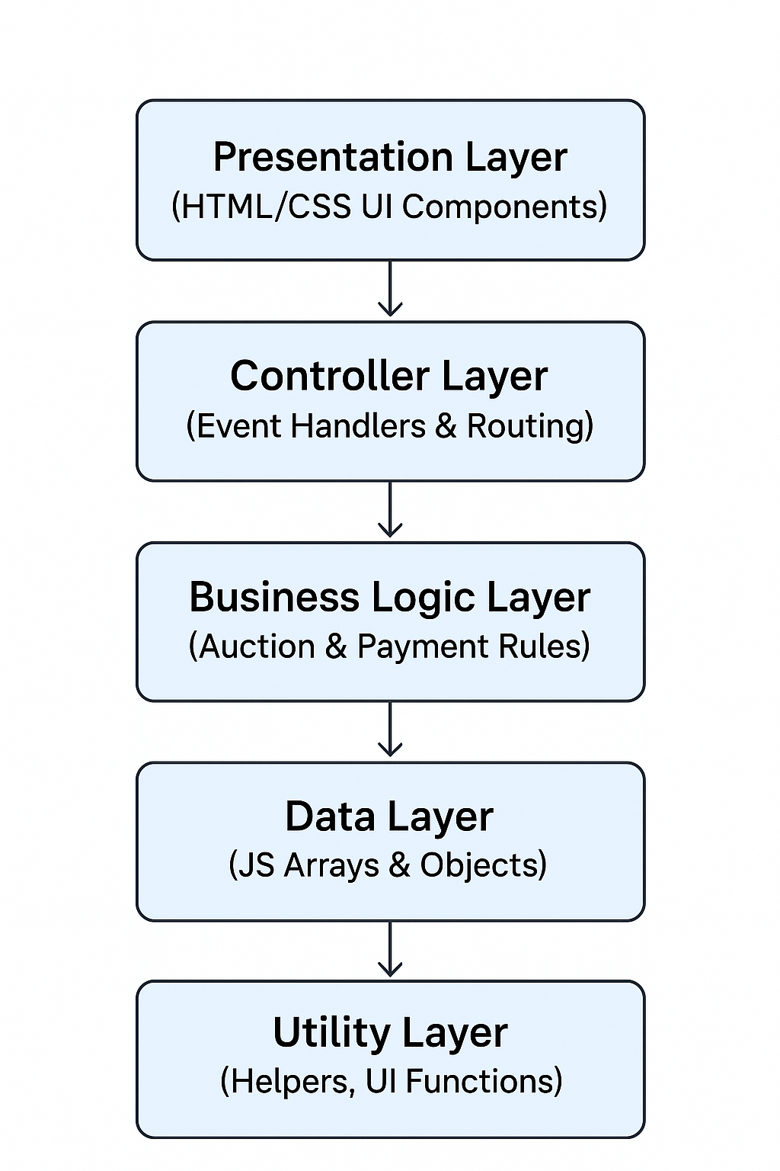
Proposed Architecture

Slide 9
Proposed Architecture - Description
Presentation Layer
Provides the user interface for registration, login, bidding, and payments using HTML & CSS.
Controller Layer
Handles form submissions and button clicks, and controls screen navigation using JavaScript event handlers.
Business Logic Layer
Implements core auction operations such as placing bids, validating highest bids, and processing payments.
Data Layer
Stores users, items, bids, and payment details using JavaScript arrays and objects.
Utility Layer
Contains helper functions such as showing messages and managing screen visibility.

Slide 10
List of Modules
1.User Module
2.Item Module
3.Auction Module
4.Bidding Module
5.Payment Module
6.Admin Module

Slide 11
Description of Modules
User Module
Registration, login, profile management (buyers & sellers).
Item Module
Add, update, delete, and view auction items.
Auction Module
Create auctions, set start/end time, auction status.
Bidding Module
Place bids, update bids, track highest bidder.
Payment Module
Simulated payment process, settlement after auction.
Admin Module
Manage users, auctions, and overall system monitoring.

Slide 12

Result

Slide 13
CONCLUSION
The Online Auction System successfully showcases the practical application of Java programming concepts such as classes, objects, ArrayList, and user input handling. The system allows sellers to add items and buyers to place bids, while automatically updating the highest bid, making the auction process simple and transparent. This project provides a functional model of an online bidding platform and helps in understanding how real auction systems work. It also creates a strong base for future enhancements such as GUI design, database integration, user authentication, and secure payment features.

Slide 14
References
1.GeeksforGeeks, “Online Auction System in Java.”
2.JavaTpoint, “Java Projects: Online Auction System.”
3.TutorialsPoint, “Object-Oriented Programming in Java.”

Slide 15
Thank You
ANY QUERIES???

